Slide 1
Circuit Simulator
Florida Get Crunk Universiteam
Group Members
Brannon Centeno, Giovanni Gastaldo,
Isaac R. Cox,
Kira Herb, Shane Jones

Slide 2
Group Members and Roles
Giovanni Gastaldo
Programmer
Isaac R. Cox
Project Leader
Programmer
Brannon Centeno
Project Manager
Programmer
Kira Herb
Documentation
Shane Jones
Documentation

Slide 3
Project Overview
This program can:
Create/delete objects that can be assembled into a circuit
Drag the objects to any location the user wants
Connect two or more objects
Allow the user to change any variable of the circuit (battery voltage, temperature, etc)

Slide 4
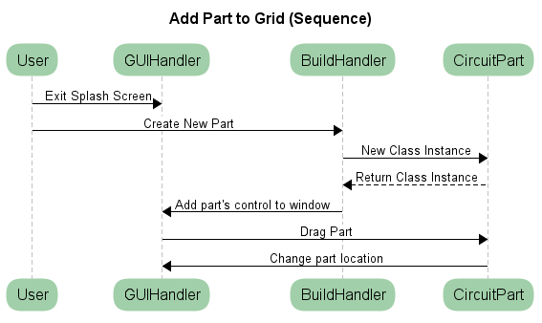
Sequence Diagram

Slide 5
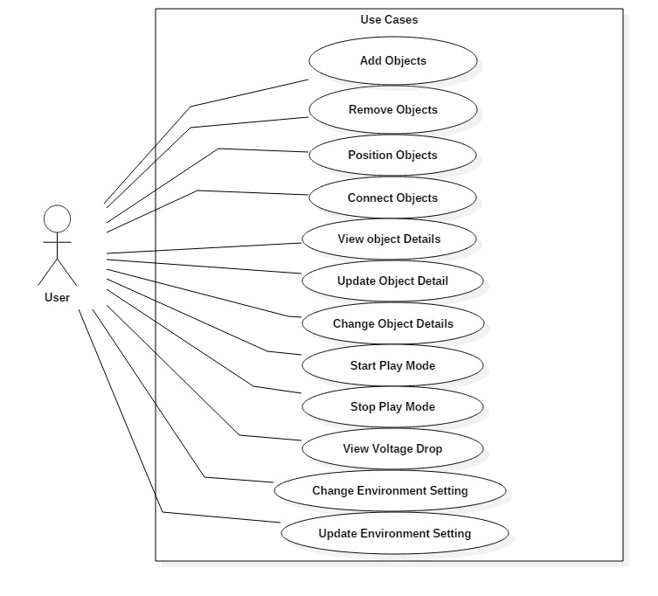
Use case Diagram

Slide 6
Coding Effort
Kira Herb – created the temperature gage window
Shane Jones – created the help window
Giovanni Gastaldo – created the GUI
Brannon Centeno – created the GUI
Isaac R. Cox – backend implementation

Slide 7
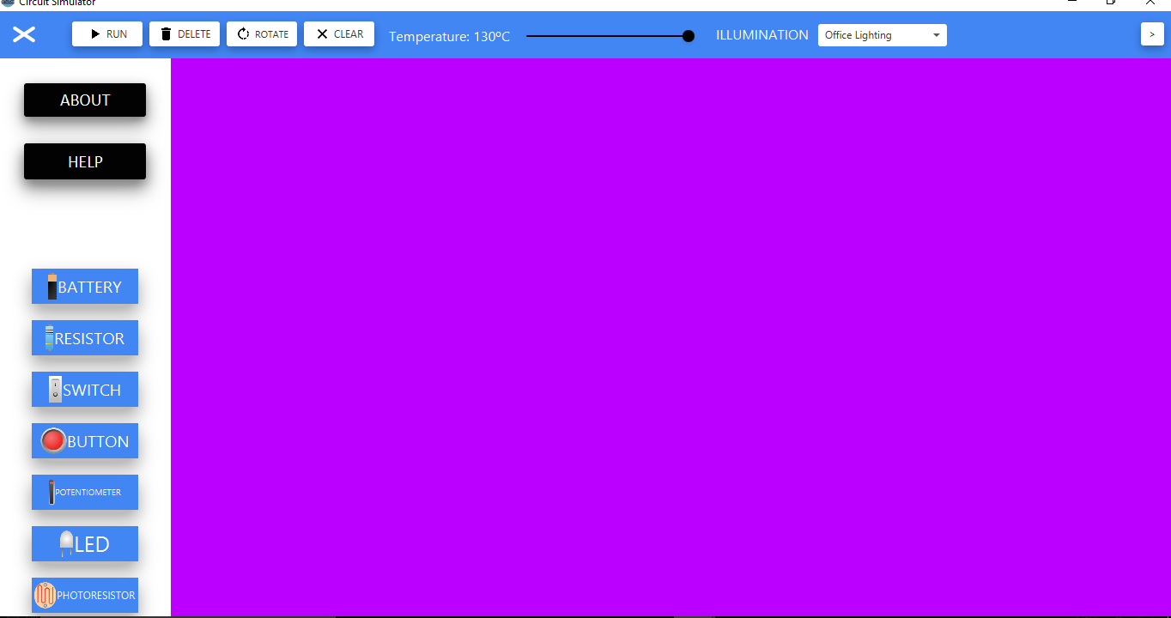
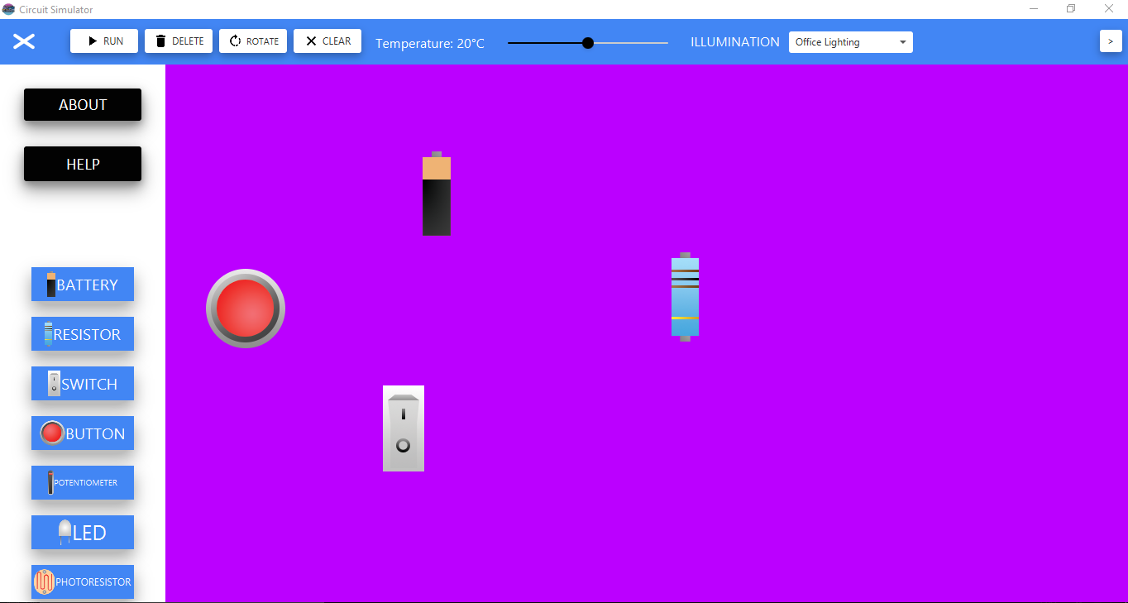
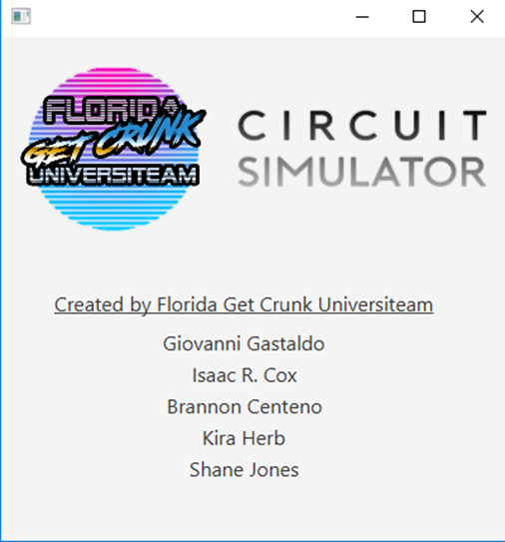
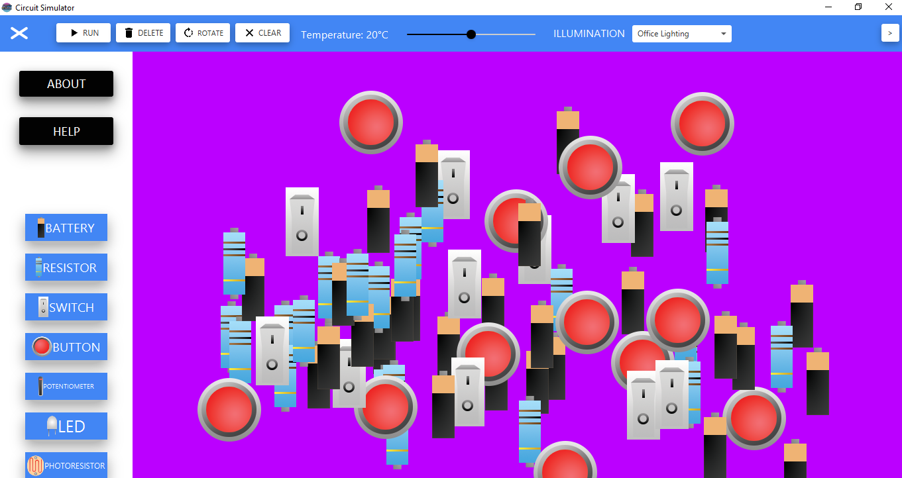

Images

Slide 8
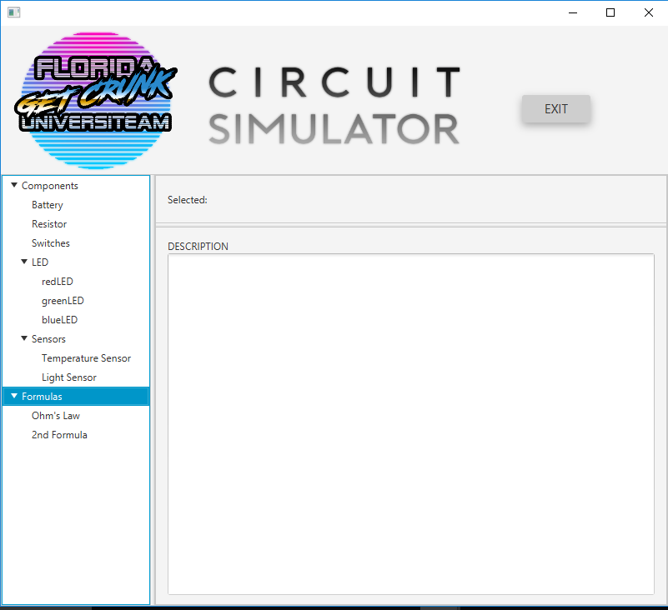
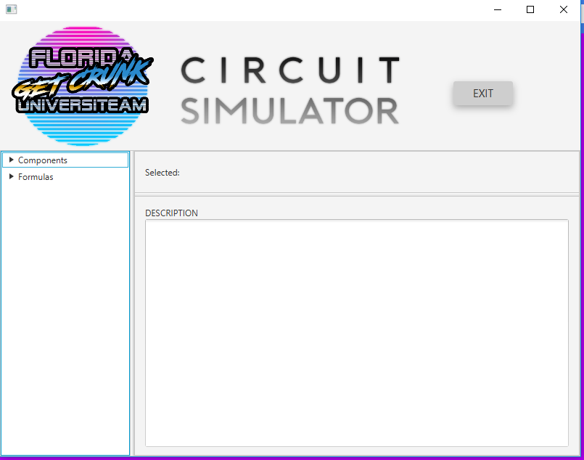
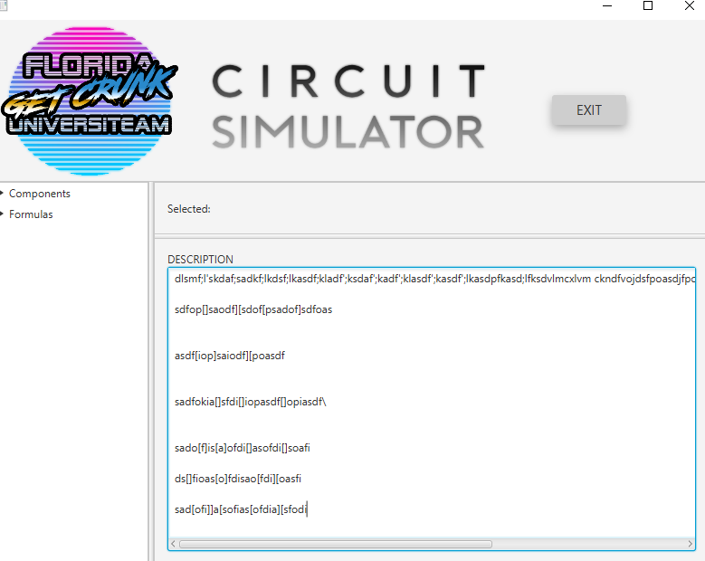
Images

Slide 9
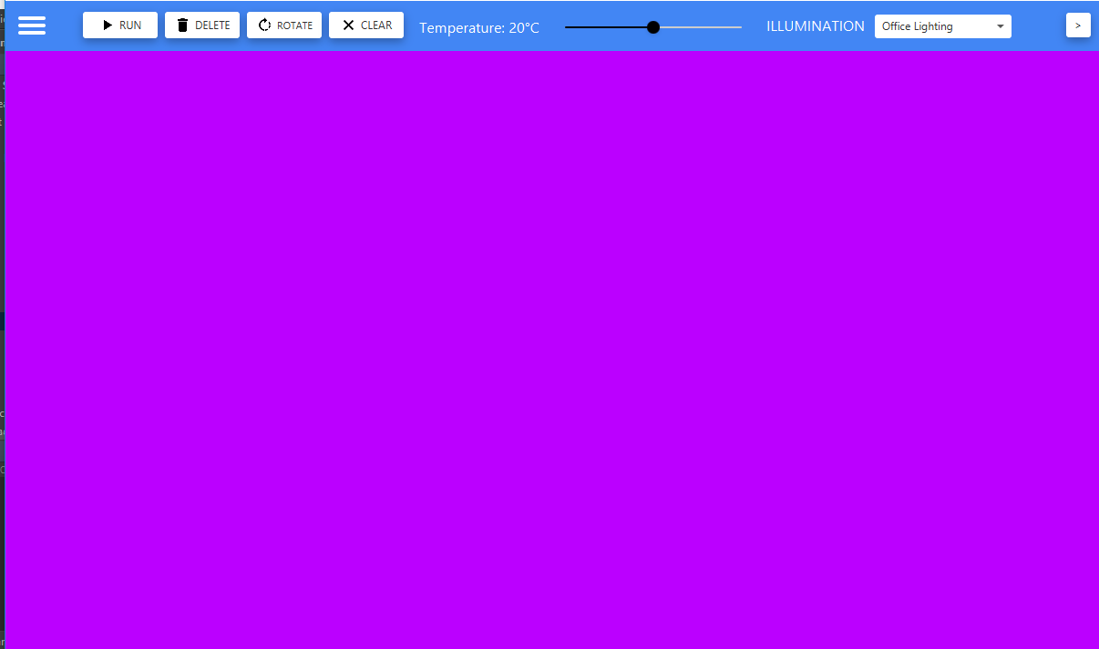
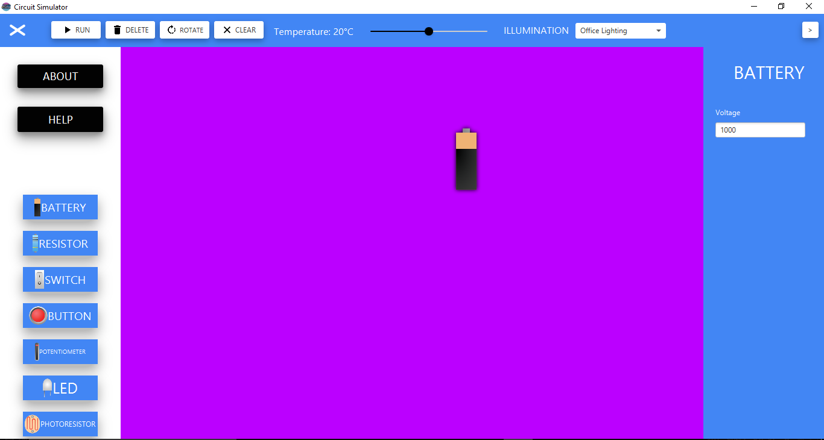
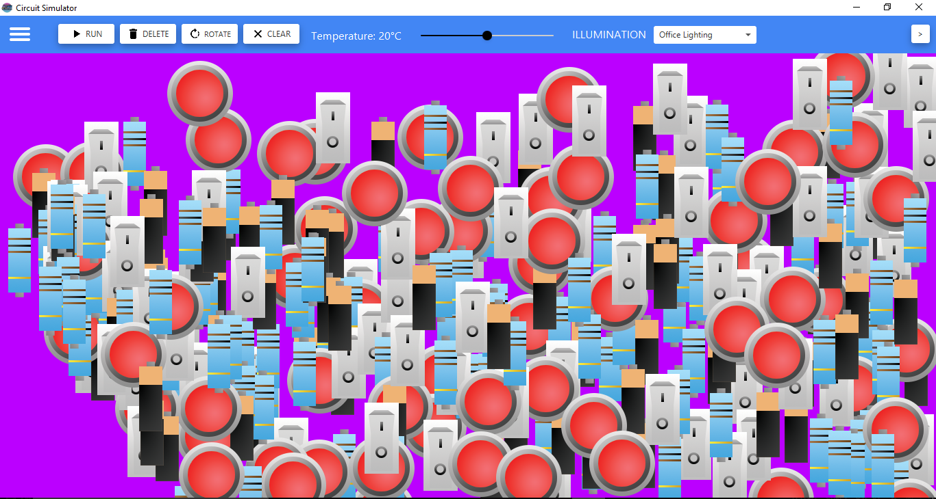
Images

Slide 10
Test Results
The following are a list of test results
Testing for correct input
Clicking and dragging objects to the main window
Deleting objects in random order still keeps the objects unqiue id
Adding a lot of components has no effect on the system!

Slide 11
Test Results

Slide 12
Webpage URL

Slide 13
Project Legacy
We met all our requirements!
Limitations

Slide 14
Project Legacy
These are the problems:
Program doesn’t visually show the connections
People can input any value for voltage (even text symbols)
LED button doesn’t create a LED
Rotate button doesn’t rotate the component’s image
Changing the illumination doesn’t change anything
No information on help screen

Slide 15
Questions And Answers
Now is the time to ask any questions on topics you may have been confused about or are just curious to know something. The floor is open…

